Slide 1



HR Data Analysis
Internship Project
Data Analyst : Nilesh Thorat

Slide 2
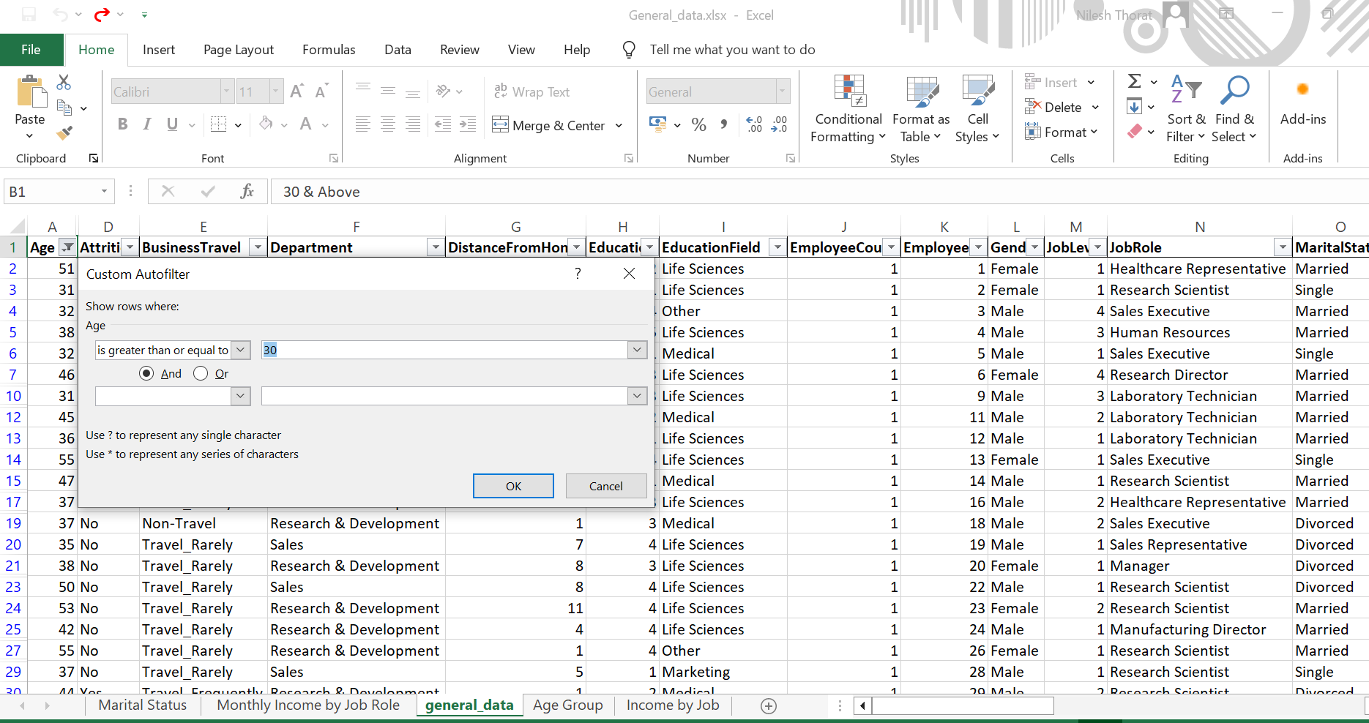
Task-1:- Using Excel, how would you filter the dataset to only show employees aged 30 and above?
Please find the below Screenshot of Employees data 30 & Above filterd

Slide 3
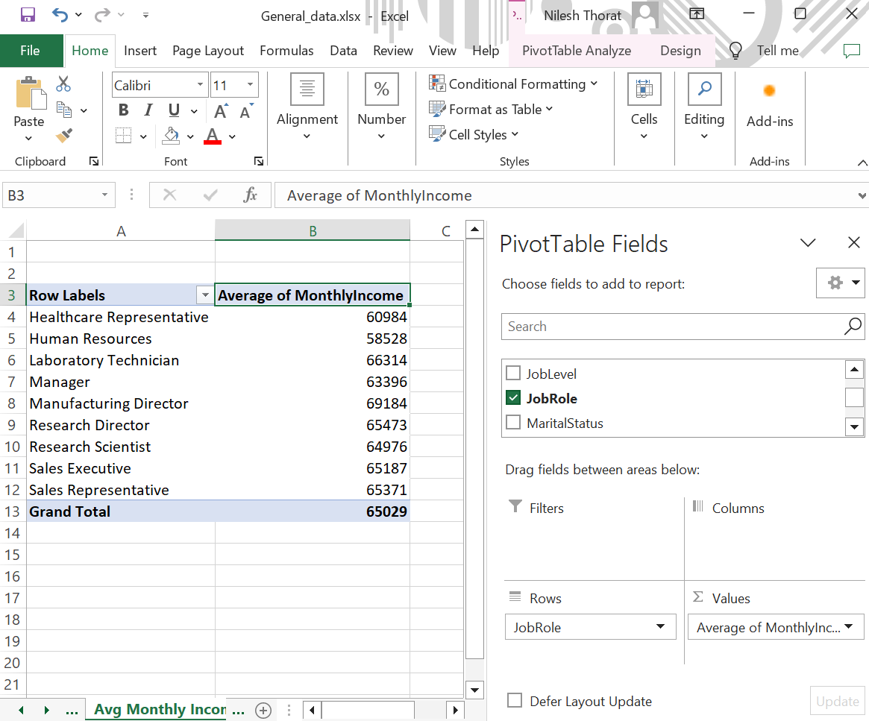
Task-2:- Create a pivot table to summarize the average Monthly Income by Job Role.
Please find the below Screenshot of outcome of Monthly Income by Job role

Slide 4
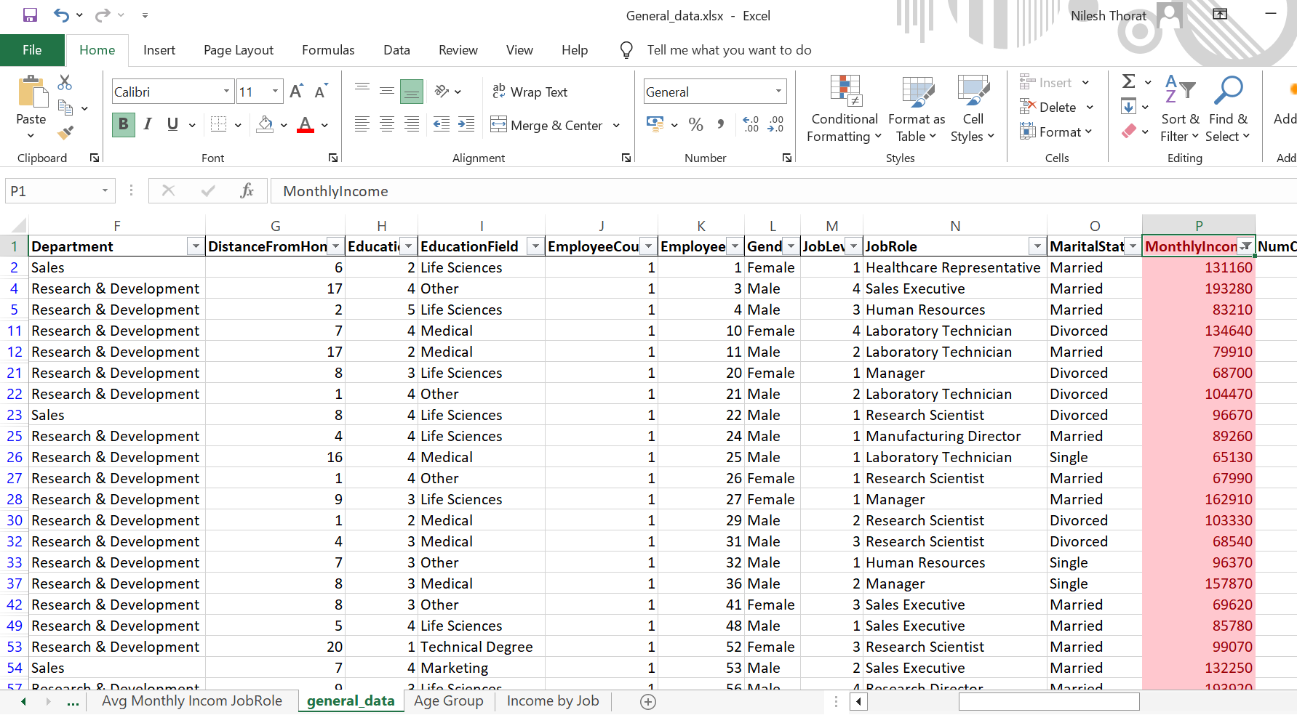
Task-3:- Apply conditional formatting to highlight employees with Monthly Income above the company's average income.
Please find the below Screenshot of Conditional formatting for Monthly Income as required

Slide 5
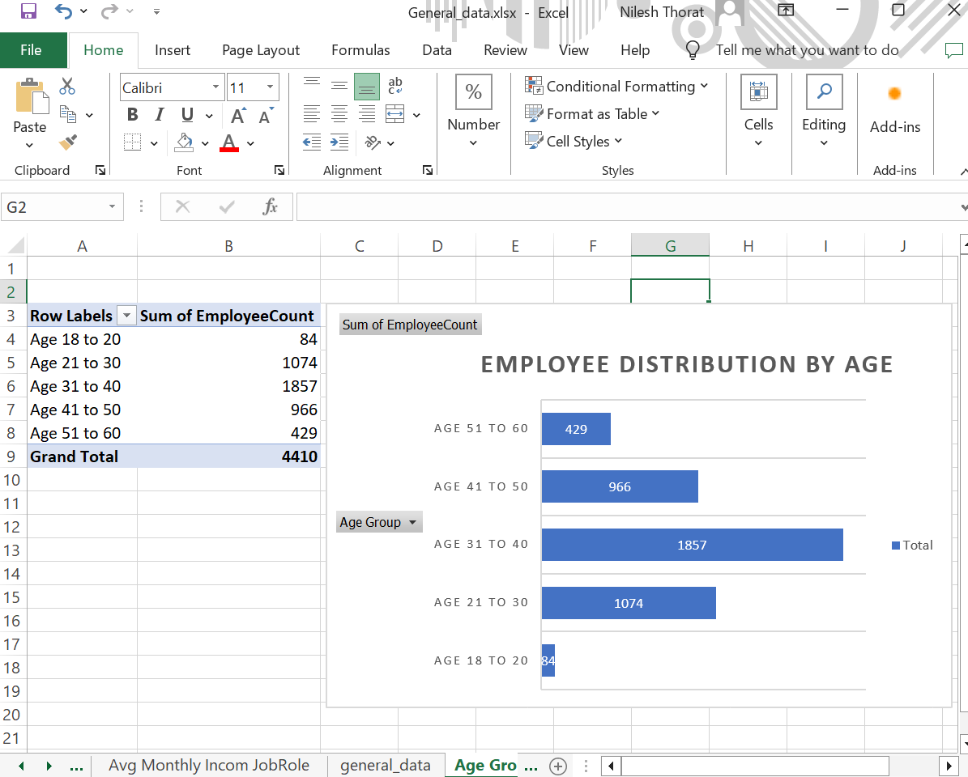
Task-4:- Create a bar chart in Excel to visualize the distribution of employee ages.
Please find the below Screenshot of Distribution of Ages in groups

Slide 6
Task-5:- Identify and clean any missing or inconsistent data in the "Department" column.
No missing or inconsistent data identified in the "Department" column.

Slide 7
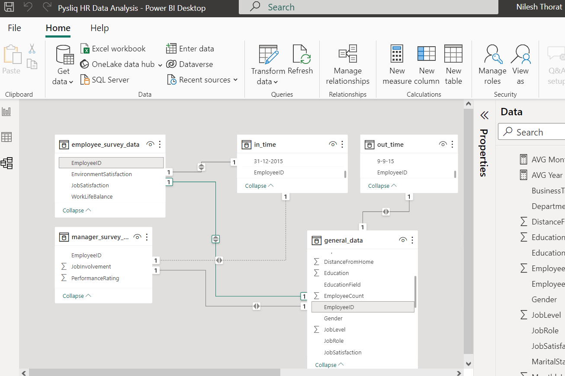
Task-6:- In Power BI, establish a relationship between the "EmployeeID" in the employee data and the "EmployeeID" in the time tracking data.
Please find the below Screenshot of Relationships in Data Modelling

Slide 8
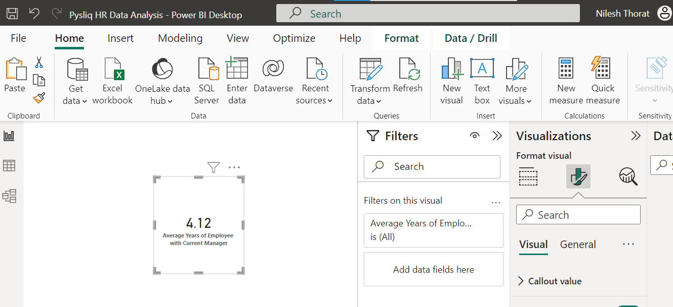
Task-7:- Using DAX, create a calculated column that calculates the average years an employee has spent with their current manager.
Please find the below Screenshot of Average years of employees with current Manager

Slide 9
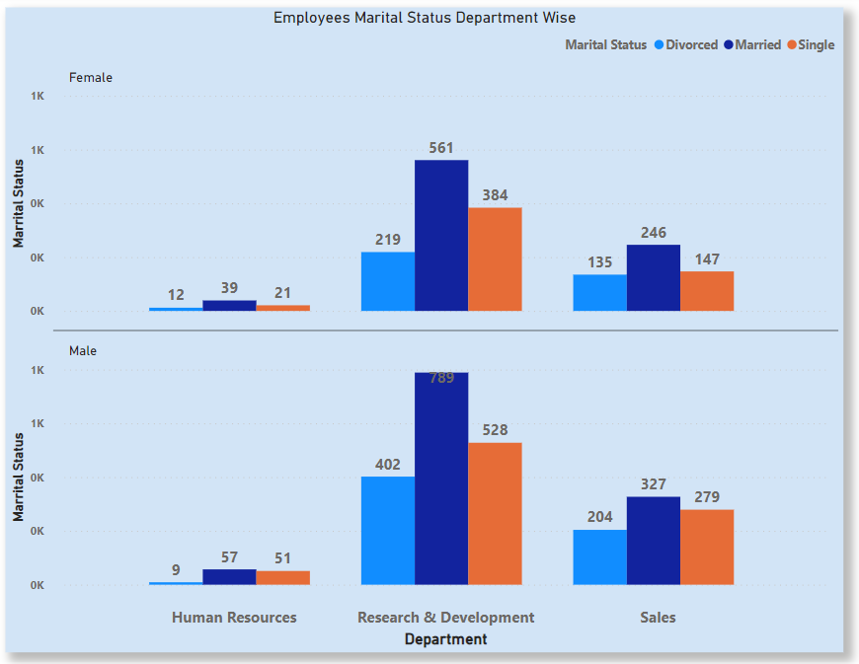
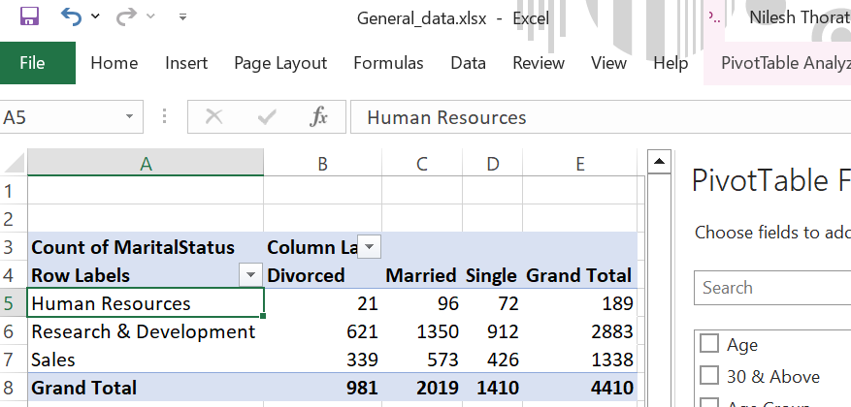
Task-8:- Using Excel, create a pivot table that displays the count of employees in each Marital Status category, segmented by Department.
Please find the below Screenshot of Marital Status by Department

Slide 10
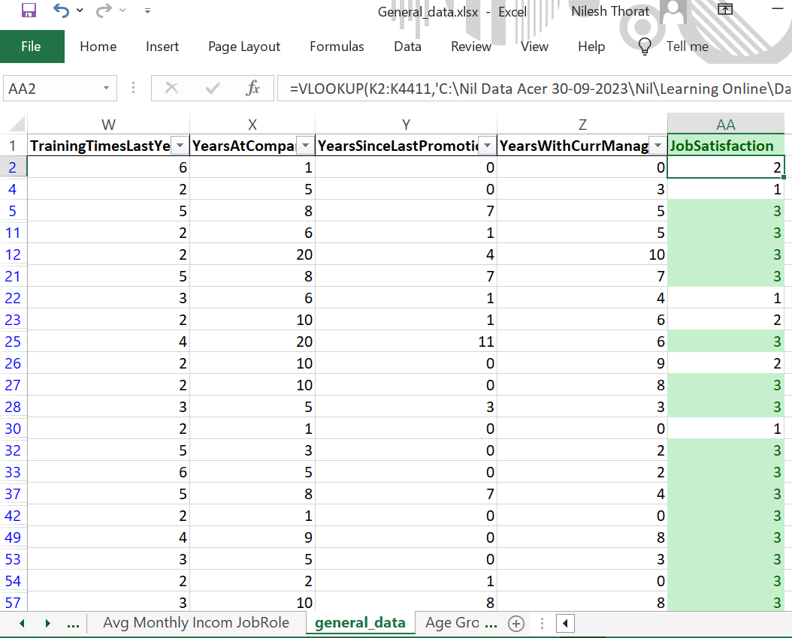
Task-9:- Apply conditional formatting to highlight employees with both above-average Monthly Income and above-average Job Satisfaction.
Please find the below Screenshot of Conditional formatting for Job Role

Slide 11
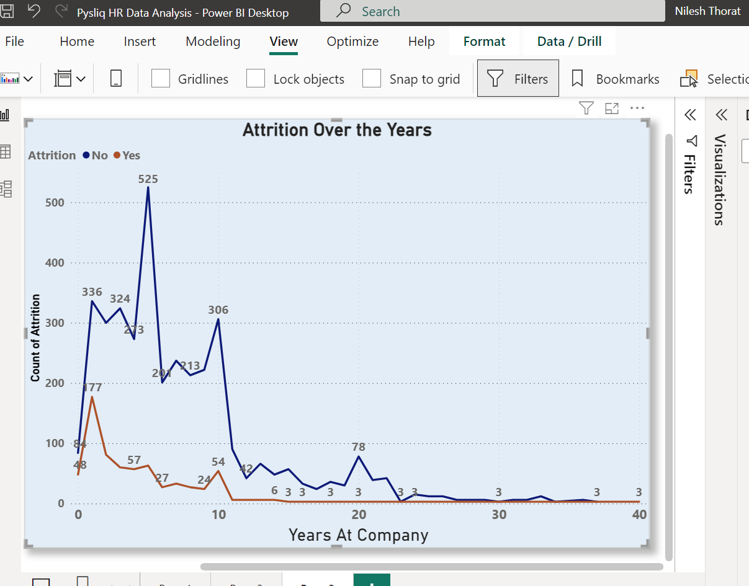
Task-10:- In Power BI, create a line chart that visualizes the trend of Employee Attrition over the years.
Please find the below Screenshot of Marital Status by Department

Slide 12
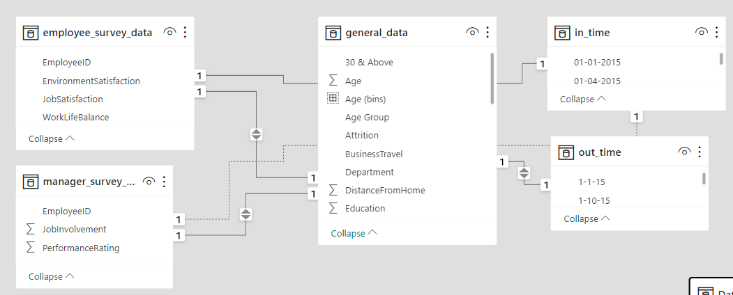
Task-11:- Describe how you would create a star schema for this dataset, explaining the benefits of doing so.
Star Schema
To create a star schema for the "General_data" dataset in Power BI, we need to organize the data into a central fact table and related dimension tables. The fact table could contain key metrics such as Monthly Income, Percent Salary Hike, and other performance-related data. Dimension tables would be created for descriptive attributes like Employee, Department, and BusinessTravel, providing additional context.
In this schema, relationships are established between the central fact table and each dimension table. In reference, the EmployeeID in the fact table would relate to the Employee dimension table, allowing for a one-to-many connection. This structure simplifies data retrieval and enhances query performance.
Benefits of Star Schema
The benefits of a star schema include improved query performance, scalability, and ease of use. By breaking down data into dimensions and a central fact table, the schema minimizes redundancy and facilitates efficient data retrieval. We can easily analyze data at different levels of granularity, and the schema adapts well to changing business requirements. Overall, a star schema enhances the organization and accessibility of data, providing a foundation for more effective data analysis in Power BI.

Slide 13
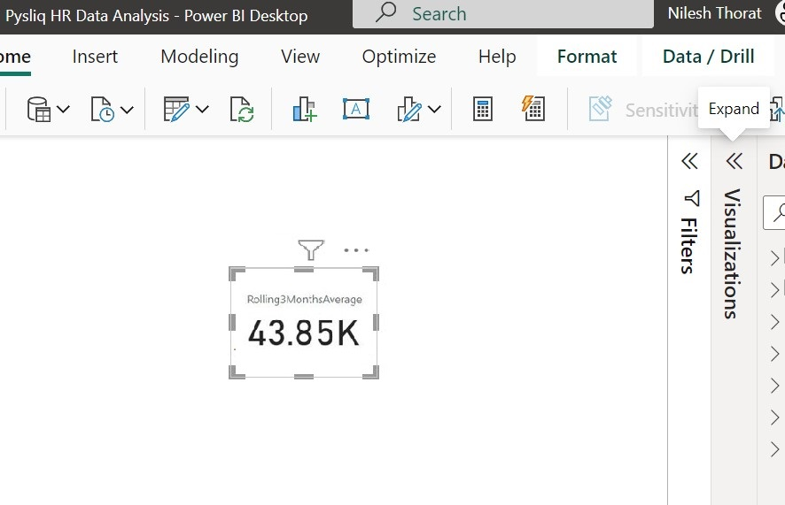
Task-12:- Using DAX, calculate the rolling 3-month average of Monthly Income for each employee.
Please find the below Screenshot of Rolling Average of Monthly Income

Slide 14
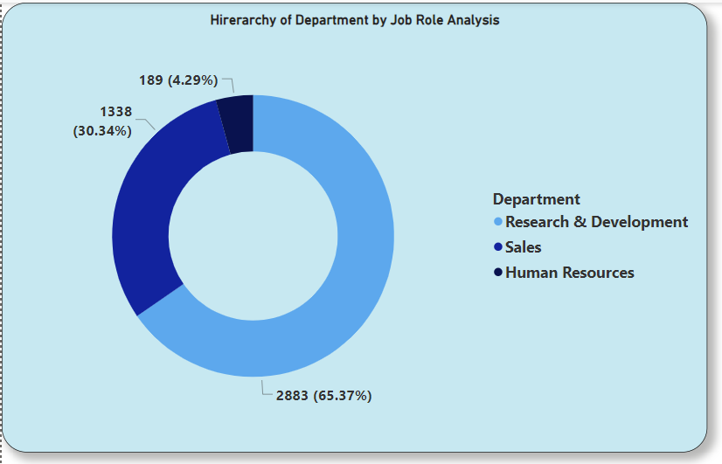
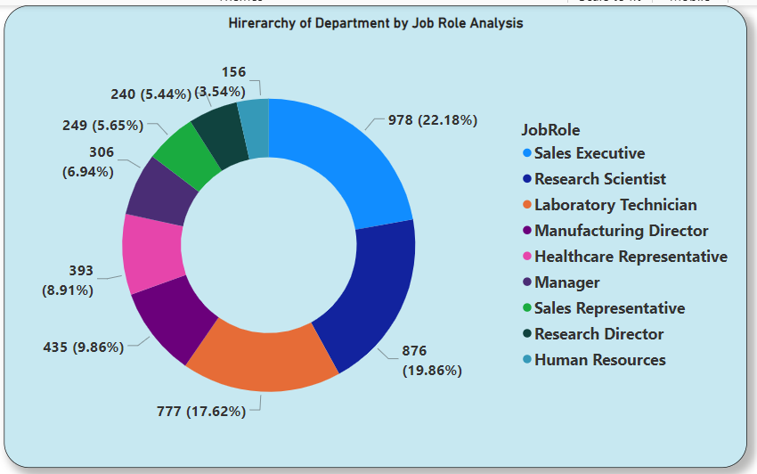
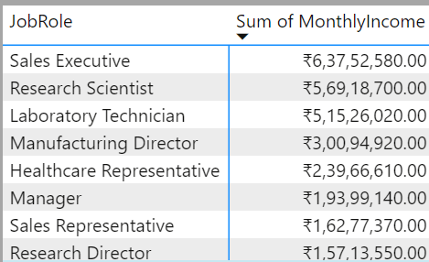
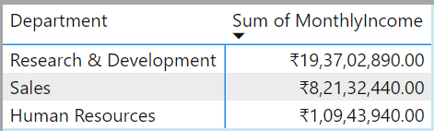
Task-13:- Create a hierarchy in Power BI that allows users to drill down from Department to Job Role to further narrow their analysis.
Please find the below Screenshots of Hierarchy with 2 Report for Jobe Role by Department with Drill down analysis

Slide 15
Task-14:- How can you set up parameterized queries in Power BI to allow users to filter data based on the Distance from Home column?
Creating Parameters
In Power BI, setting up parameterized queries allows users to dynamically filter data based on the Distance from Home column. First, create a parameter by navigating to the "Modelling" tab and selecting "New Parameters." Define the parameter with a name as "DistanceParameter" and a data type. Set a default value for the parameter, and save it.
Next, opening the Query Editor and locate the query associated with your data. Filter the Distance from Home column using the parameter by selecting "Custom Filter" and referencing the parameter instead of a constant value. Apply the changes, and use the parameter in visualizations or measures.
In Power BI Desktop, we can interactively adjust the parameter, influencing the data shown in the reports. When publishing the Power BI file to the Power BI service, configure the parameter values in the dataset settings. This enables users to continue dynamically filtering data based on the Distance from Home column in the Power BI service.

Slide 16
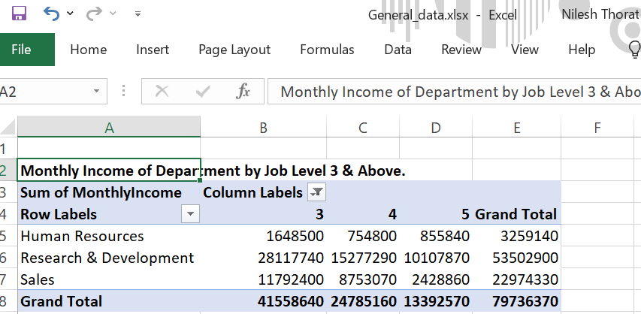
Task-15:- In Excel, calculate the total Monthly Income for each Department, considering only the employees with a Job Level greater than or equal to 3.
Please find the below Screenshot of Monthly Income by Job Level 3 & Above

Slide 17
Task-16:- Explain how to perform a What-If analysis in Excel to understand the impact of a 10% increase in Percent Salary Hike on Monthly Income.
What if Analysis
Performing a What-If analysis in Excel involves creating scenarios to understand the potential impact of changes in certain variables on the results. In this case, we can analyze the impact of Salary hike of percentage % increase on Monthly Income.
Considering the columns for "PercentSalaryHike" and "MonthlyIncome" Ensuring the clear understanding of the relationships between these columns.
Navigate to the "Data" tab in the Excel ribbon. Selecting the “What-If Analysis”, Choose Scenario Manager from the dropdown menu. Creating new Scenario Manager by giving descriptive name, such as "10% Salary Increase.
In the "Changing cells" field, specify the cells that will change in your scenario. In this case, enter the cell reference for the Percent Salary Hike. Enter the new values for the scenario. For a 10% increase, set the new value for Percent Salary Hike to 10%
View results in the Scenario Manager dialog box, select the scenario you just created and click "Show." Excel will apply the scenario, and you can observe how the changes in Percent Salary Hike impact the Monthly Income.

Slide 18
Task-17:- Verify if the data adheres to a predefined schema. What actions would you take if you find inconsistencies?
Data Adherence to the Schema
Ensuring the adherence of HR data in the "general_data" as the fact table and other dimensional tables dataset to a predefined schema is pivotal for data accuracy and reliability. Begin by reviewing the predefined schema or data dictionary to understand the expected structure, data types, and constraints for each column. Check that columns have the correct data types, maintain referential integrity, and adhere to unique constraints.
Evaluate the dataset for missing values, ensuring they align with the schema's expectations, and decide whether imputation or exclusion is appropriate. Validate numeric columns against expected ranges and identify outliers for investigation. Inconsistencies should prompt actions such as imputation, removal of duplicates, or addressing outliers based on their validity.
Documentation is crucial throughout this process, capturing issues, actions taken, and the rationale behind decisions. Establish ongoing data quality checks and collaborate with stakeholders responsible for data entry or system maintenance to address root causes. By systematically verifying and addressing inconsistencies, you can enhance data reliability, contributing to more informed HR data analysis and strategic decision-making.

Slide 19
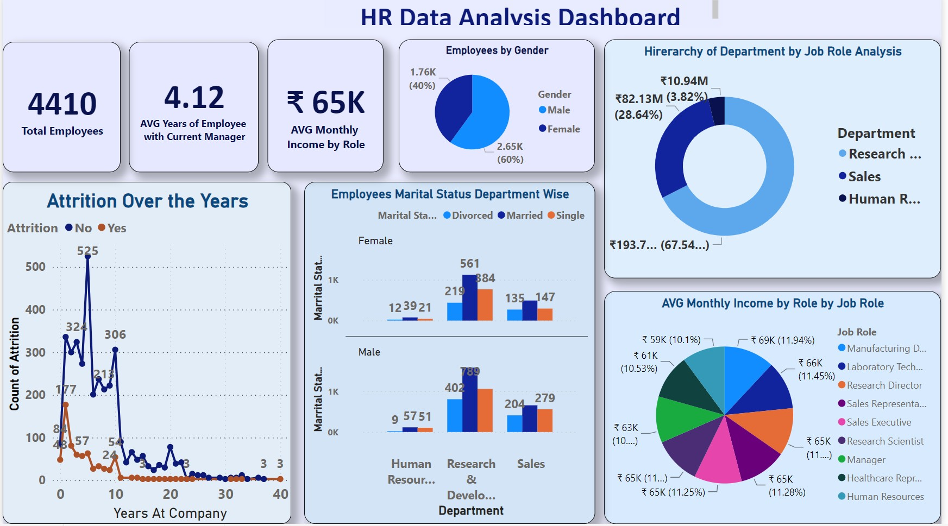
HR Data Analysis Dashboard

Slide 20
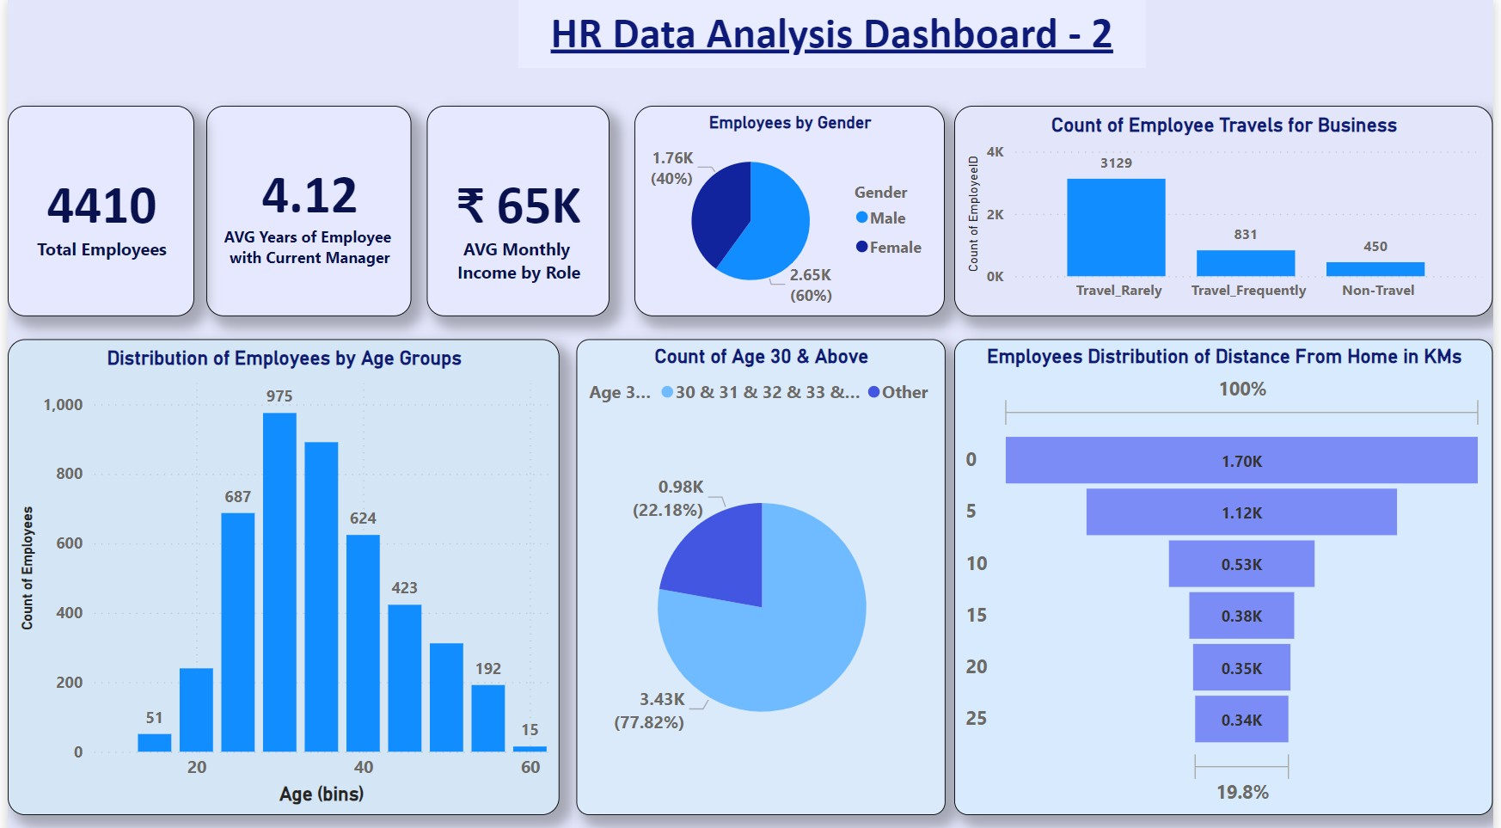
HR Data Analysis Dashboard

Slide 21
HR Data Analysis Power BI Dashboard Linke below https://app.powerbi.com/links/_Y0vqNTnhu?ctid=63ceb0d1-d097-4fb5-a3aa-b89884101980&pbi_source=linkShare

Slide 22
Thank You
Data Analyst – Nilesh Thorat Email : nilesh.thorat01@gmail.com Linkedin: www.linkedin.com/in/nileshthorat

